Slide 1
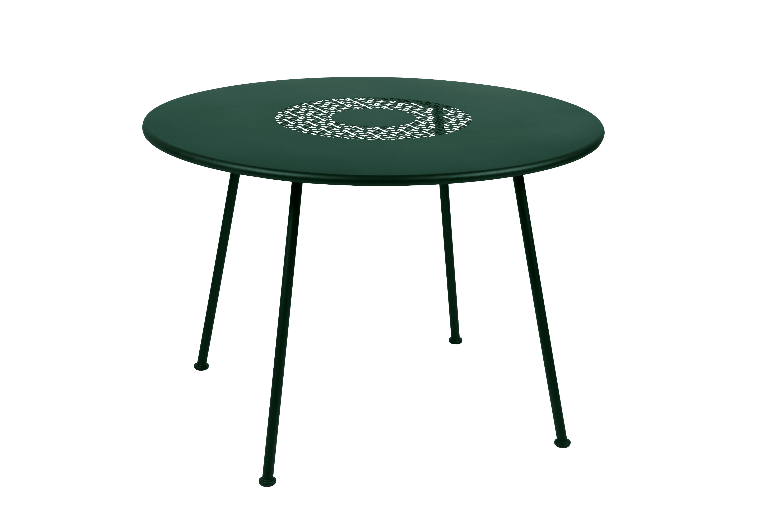
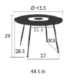
Lorette
Round Table 43”
Item: 5761
Table top perforated
Laser-cut electro-galvanized steel
Base steel tube
Suitable for contract use
UV Resistant
Shown in Cedar Green
Available in our
standard palette of 24 colors.
fermobUSA.com

