Slide 1
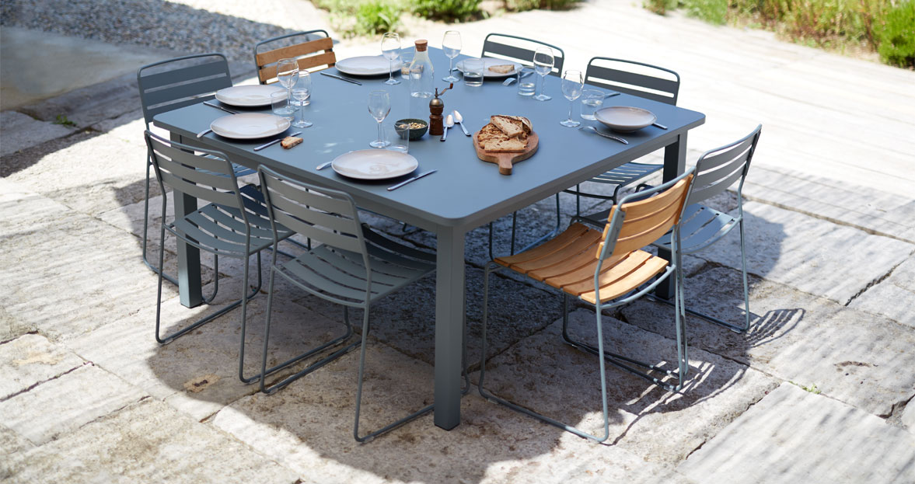
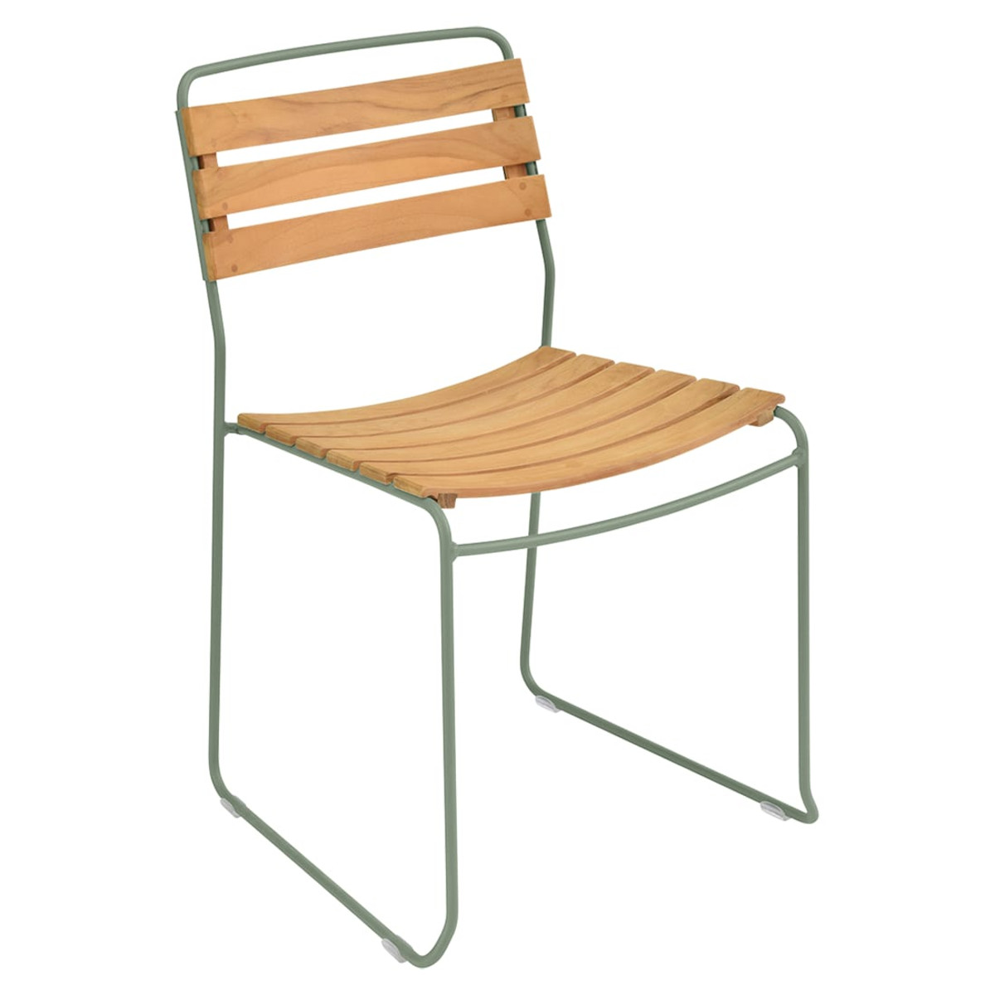
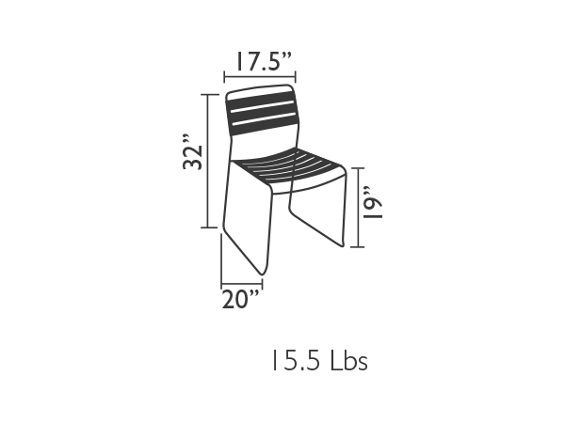
Surprising
Teak Chair
Item: 1240
Steel rod frame with electrolytic coating
Teak seat and backrest (natural, non-oiled, grade C)
Stacking: x7
Very High Protection
UV-Resistant
Suitable for contract use
Shown in Cactus
Available in our
standard palette of 24 colors.
fermobUSA.com

