Slide 1
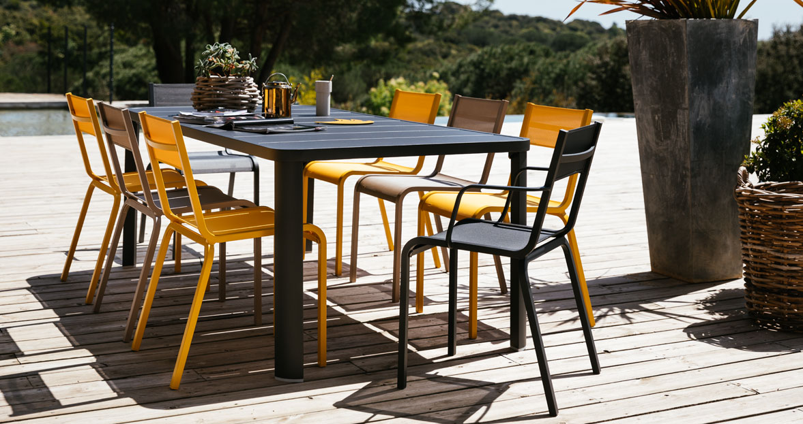
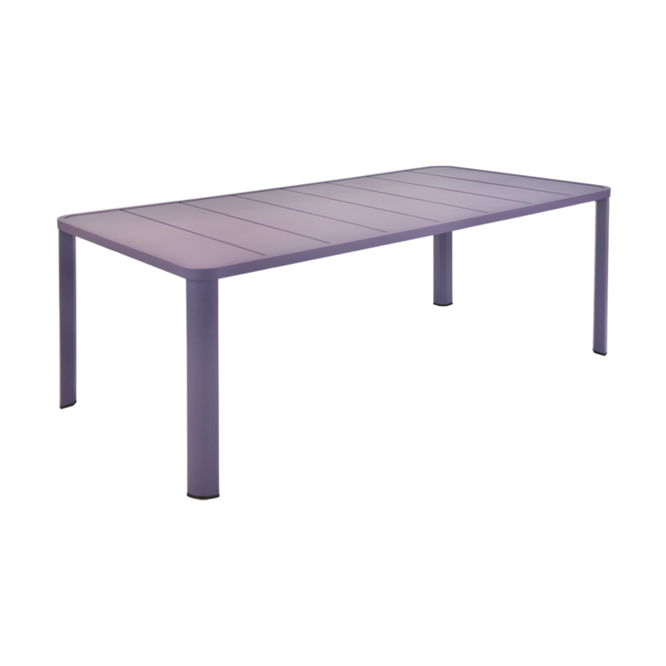
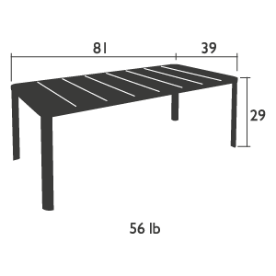
Oleron
Table
Item: 5531
Aluminum tube frame
Aluminum slatted table top
Very High Protection
UV-Resistant
Requires an assembly
Suitable for 8/10 persons
Suitable for contract
Shown in Plum
Available in our
standard palette of 24 colors.
fermobUSA.com

