Slide 1
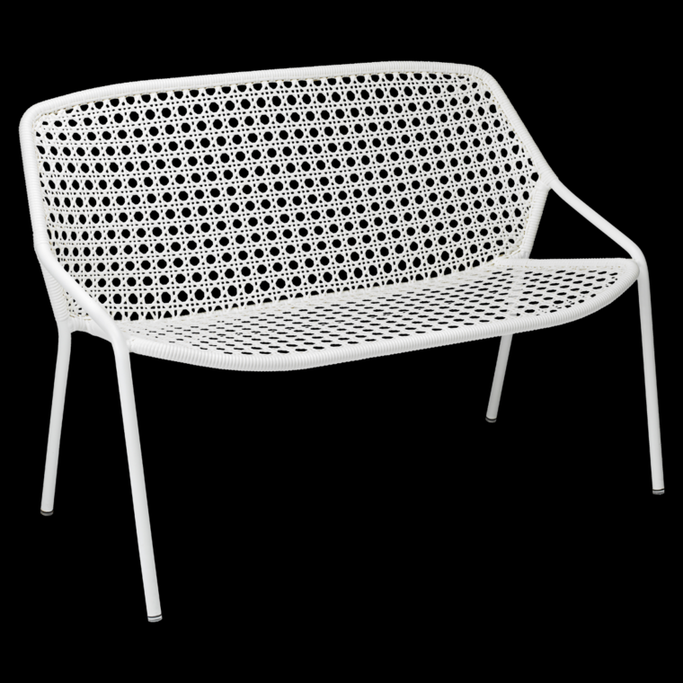
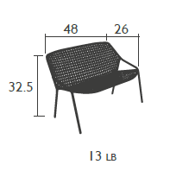
Croisette
Bench
Item: 1805
Aluminum frame
Weave made from outdoor polyethylene synthetic fibers
Stacking: x4 (stacked height: 39’’)
Very High Protection
UV-Resistant
Suitable for 2/3 persons
Silence pads
Suitable for contract use
Shown in Cotton White
Available colors.
fermobUSA.com

