Slide 1
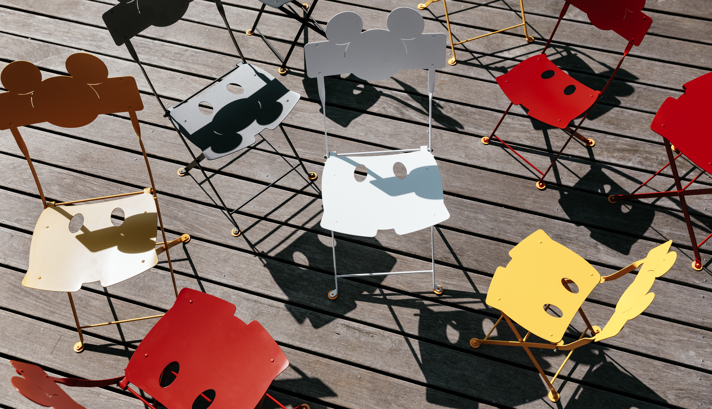
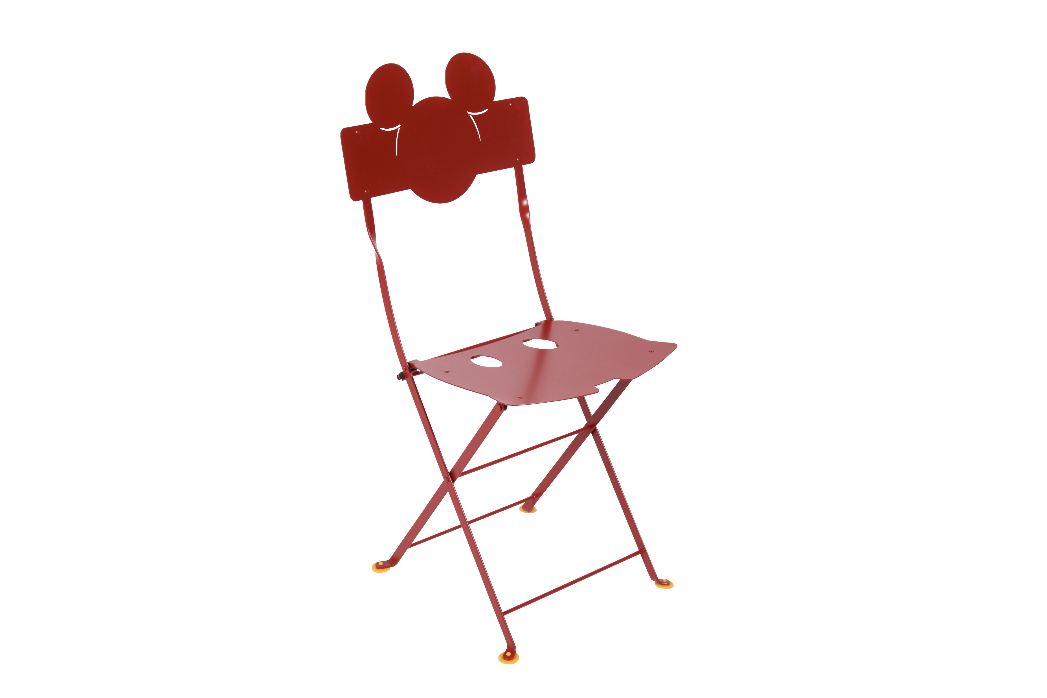
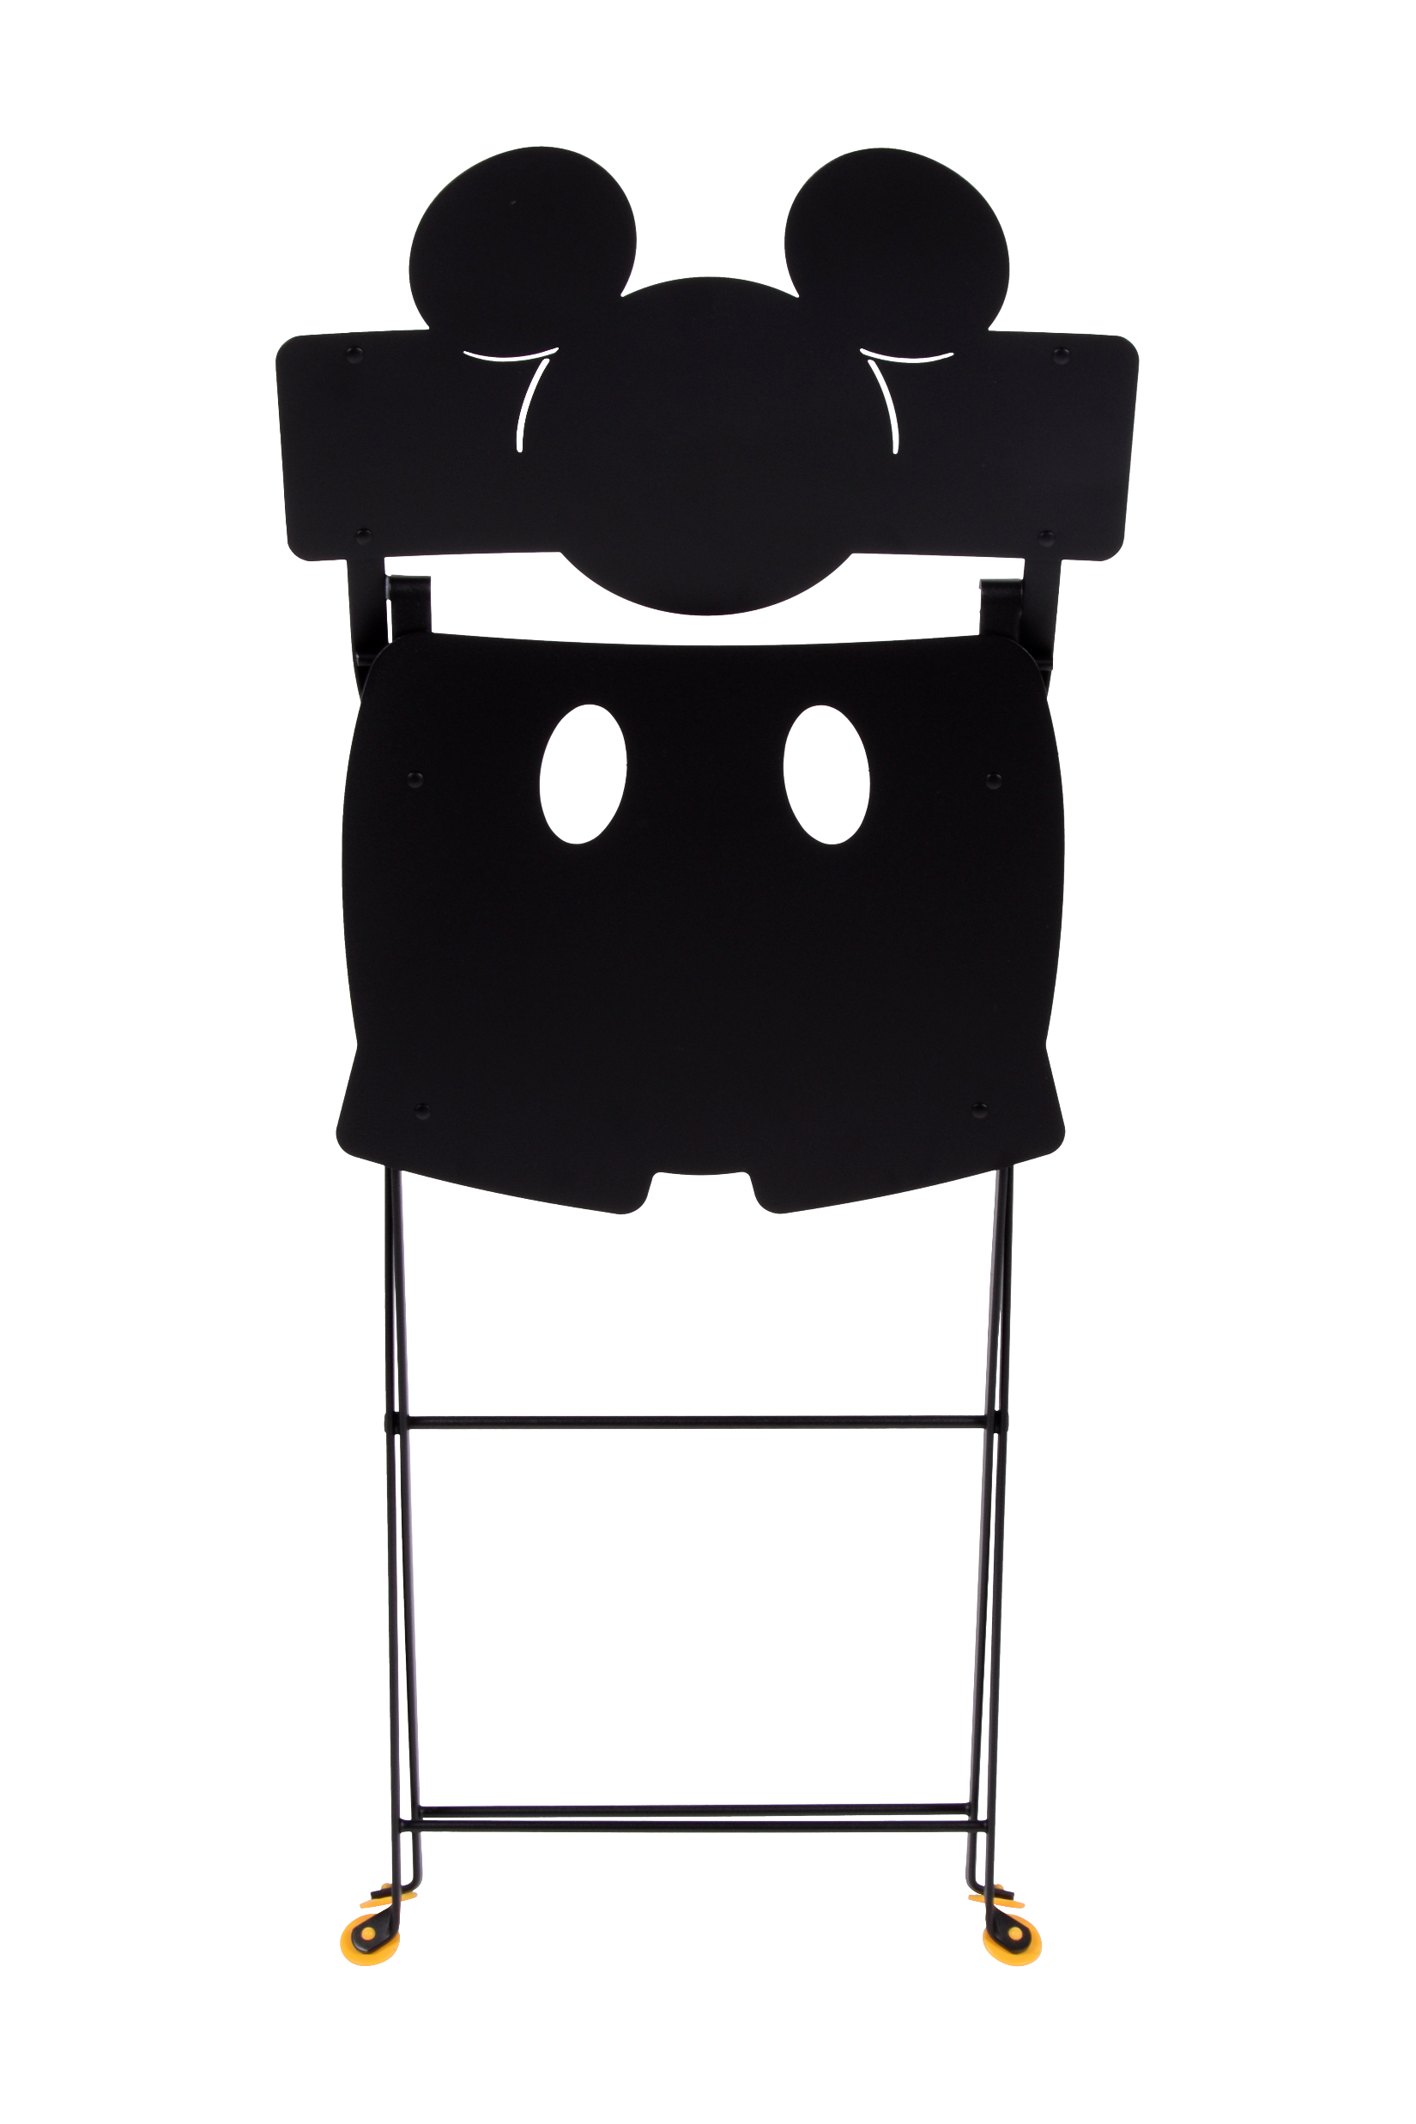
Mickey
Bistro Chair
Item: 3212
Frame Steel
Seat curved in lase-cut galvanized steel
Backrest laser-cut electro-galvanized steel
Suitable for contract use
UV resistant
Shown in Poppy red
Available 4 colors.
fermobUSA.com

